Slide 1
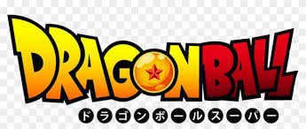
Dragon Ball
Title: Dragon Ball: The Legendary Anime Saga Subtitle: A Journey Through the World of Saiyans

Slide 2

Introduction
What is Dragon Ball?
A Japanese anime and manga franchise created by Akira Toriyama.
First aired in 1986; based on the manga serialized in Weekly Shonen Jump.
Follows the adventures of Son Goku and his journey to become the strongest martial artist

Slide 3
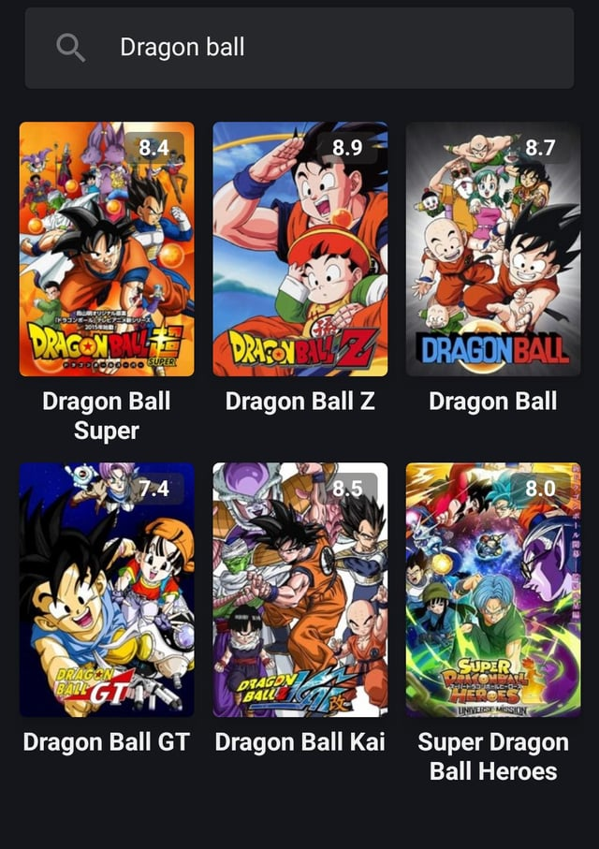
Series Overview
Main Series Titles:
Dragon Ball (1986–1989)
Dragon Ball Z (1989–1996)
Dragon Ball GT (1996–1997)
Dragon Ball Super (2015–2018)
Dragon Ball Heroes (Promotional Anime)

Slide 4
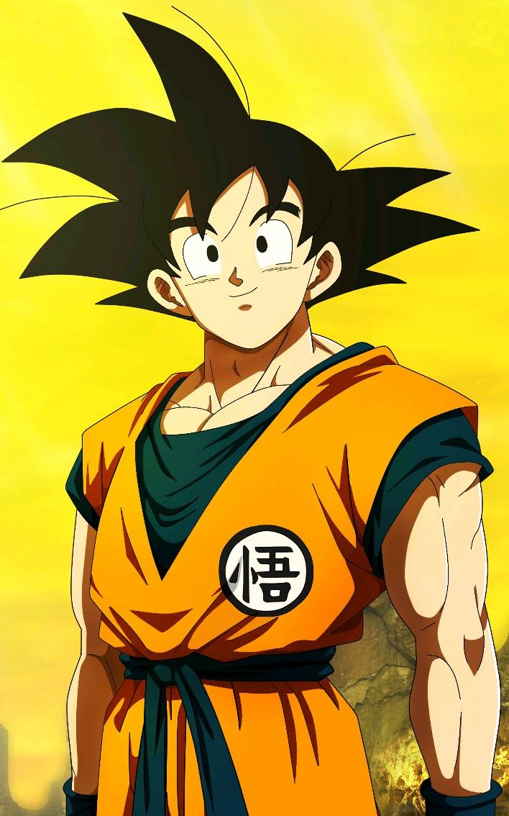
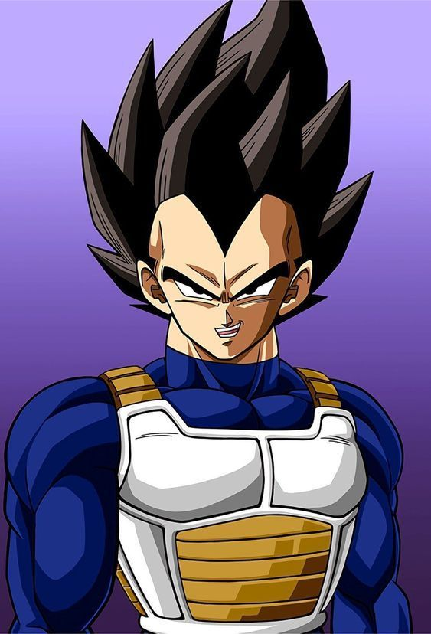
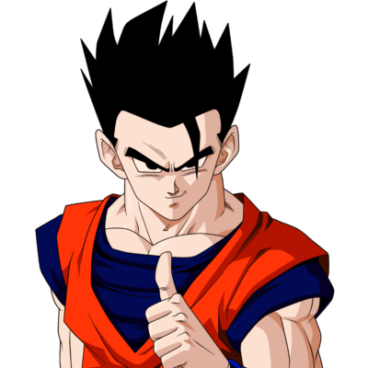
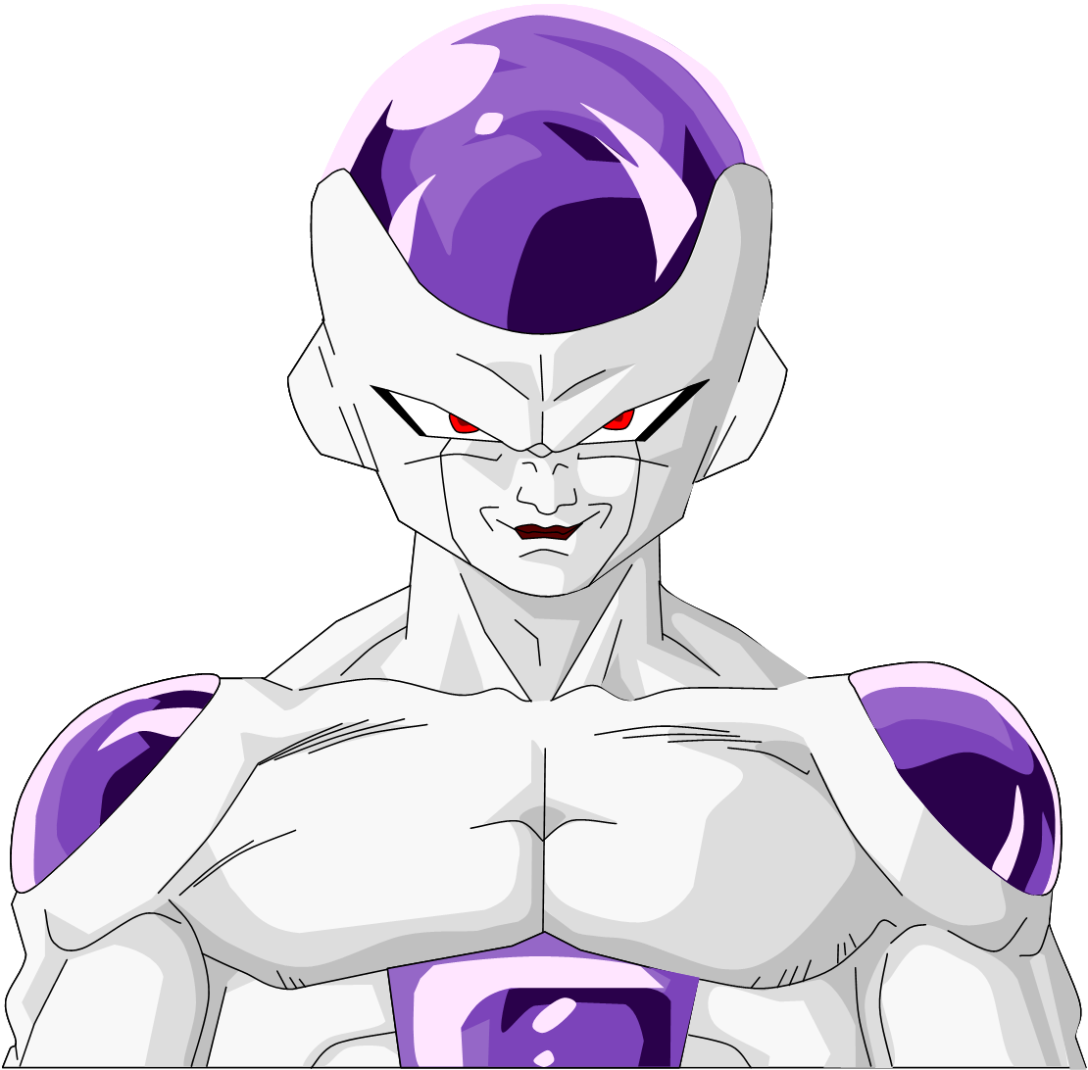
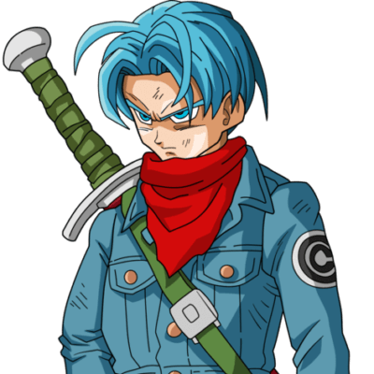
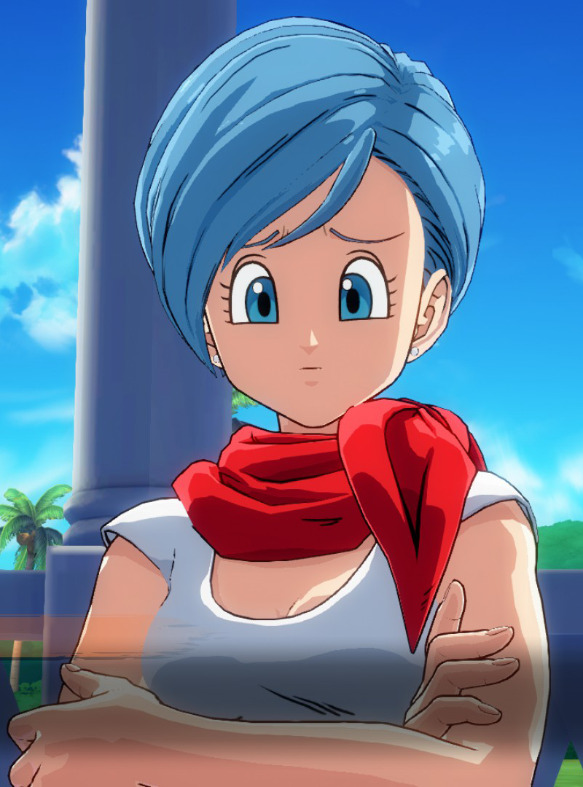
Main Characters
Son Goku – Saiyan warrior, cheerful and pure-hearted.
Vegeta – Prideful Prince of the Saiyans.
Bulma – Genius inventor and early adventurer.
Piccolo – Warrior from Namek, mentor to Gohan.
Gohan, Trunks, Krillin, Frieza, Cell, Majin Buu, etc.

Slide 5
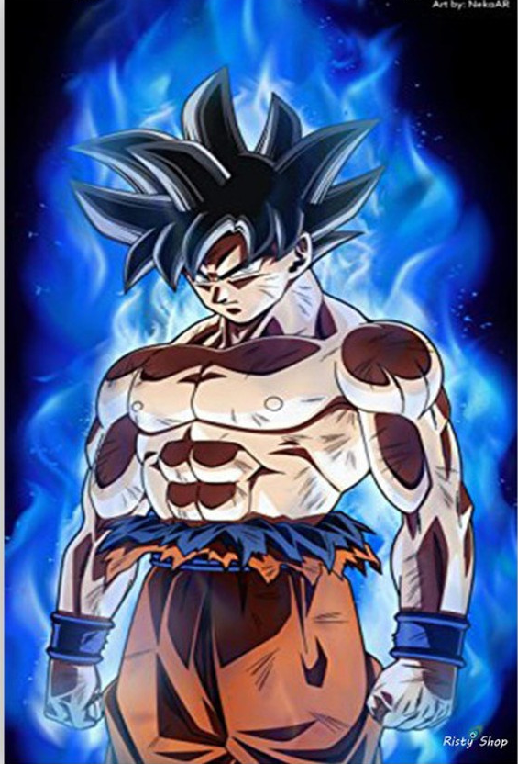
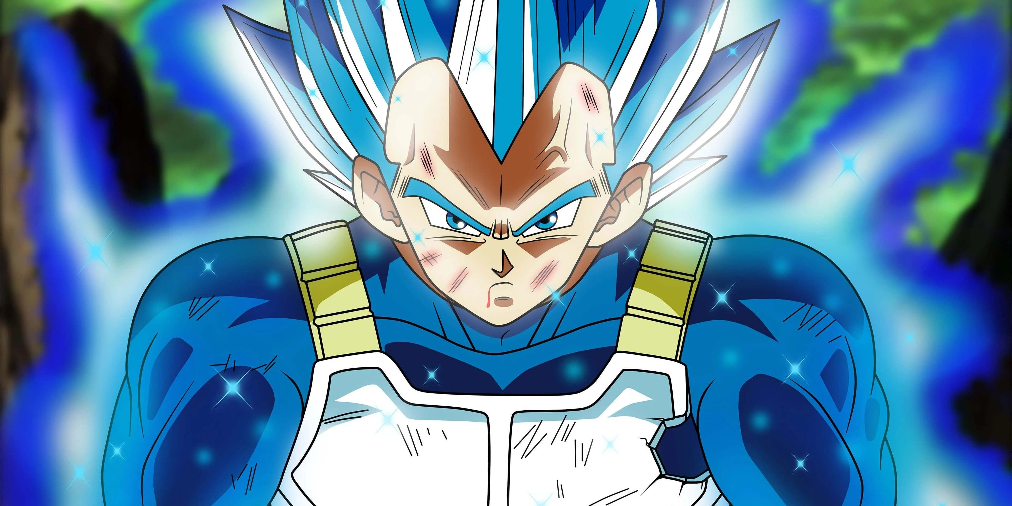
Iconic Transformations
Super Saiyan Forms (SSJ, SSJ2, SSJ3, God, Blue, Ultra Instinct)
Significance of transformations in battles and storytelling

Slide 6
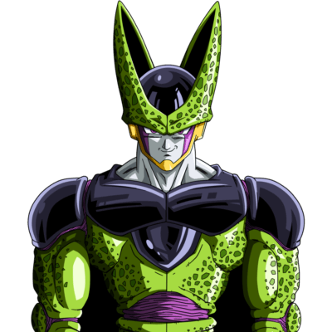
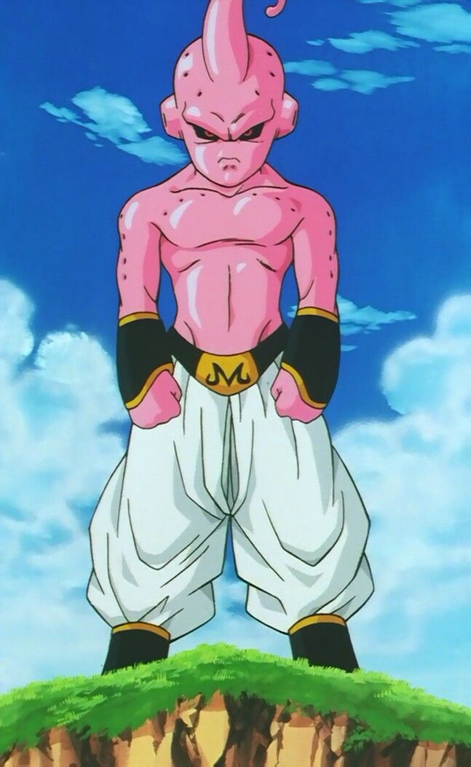
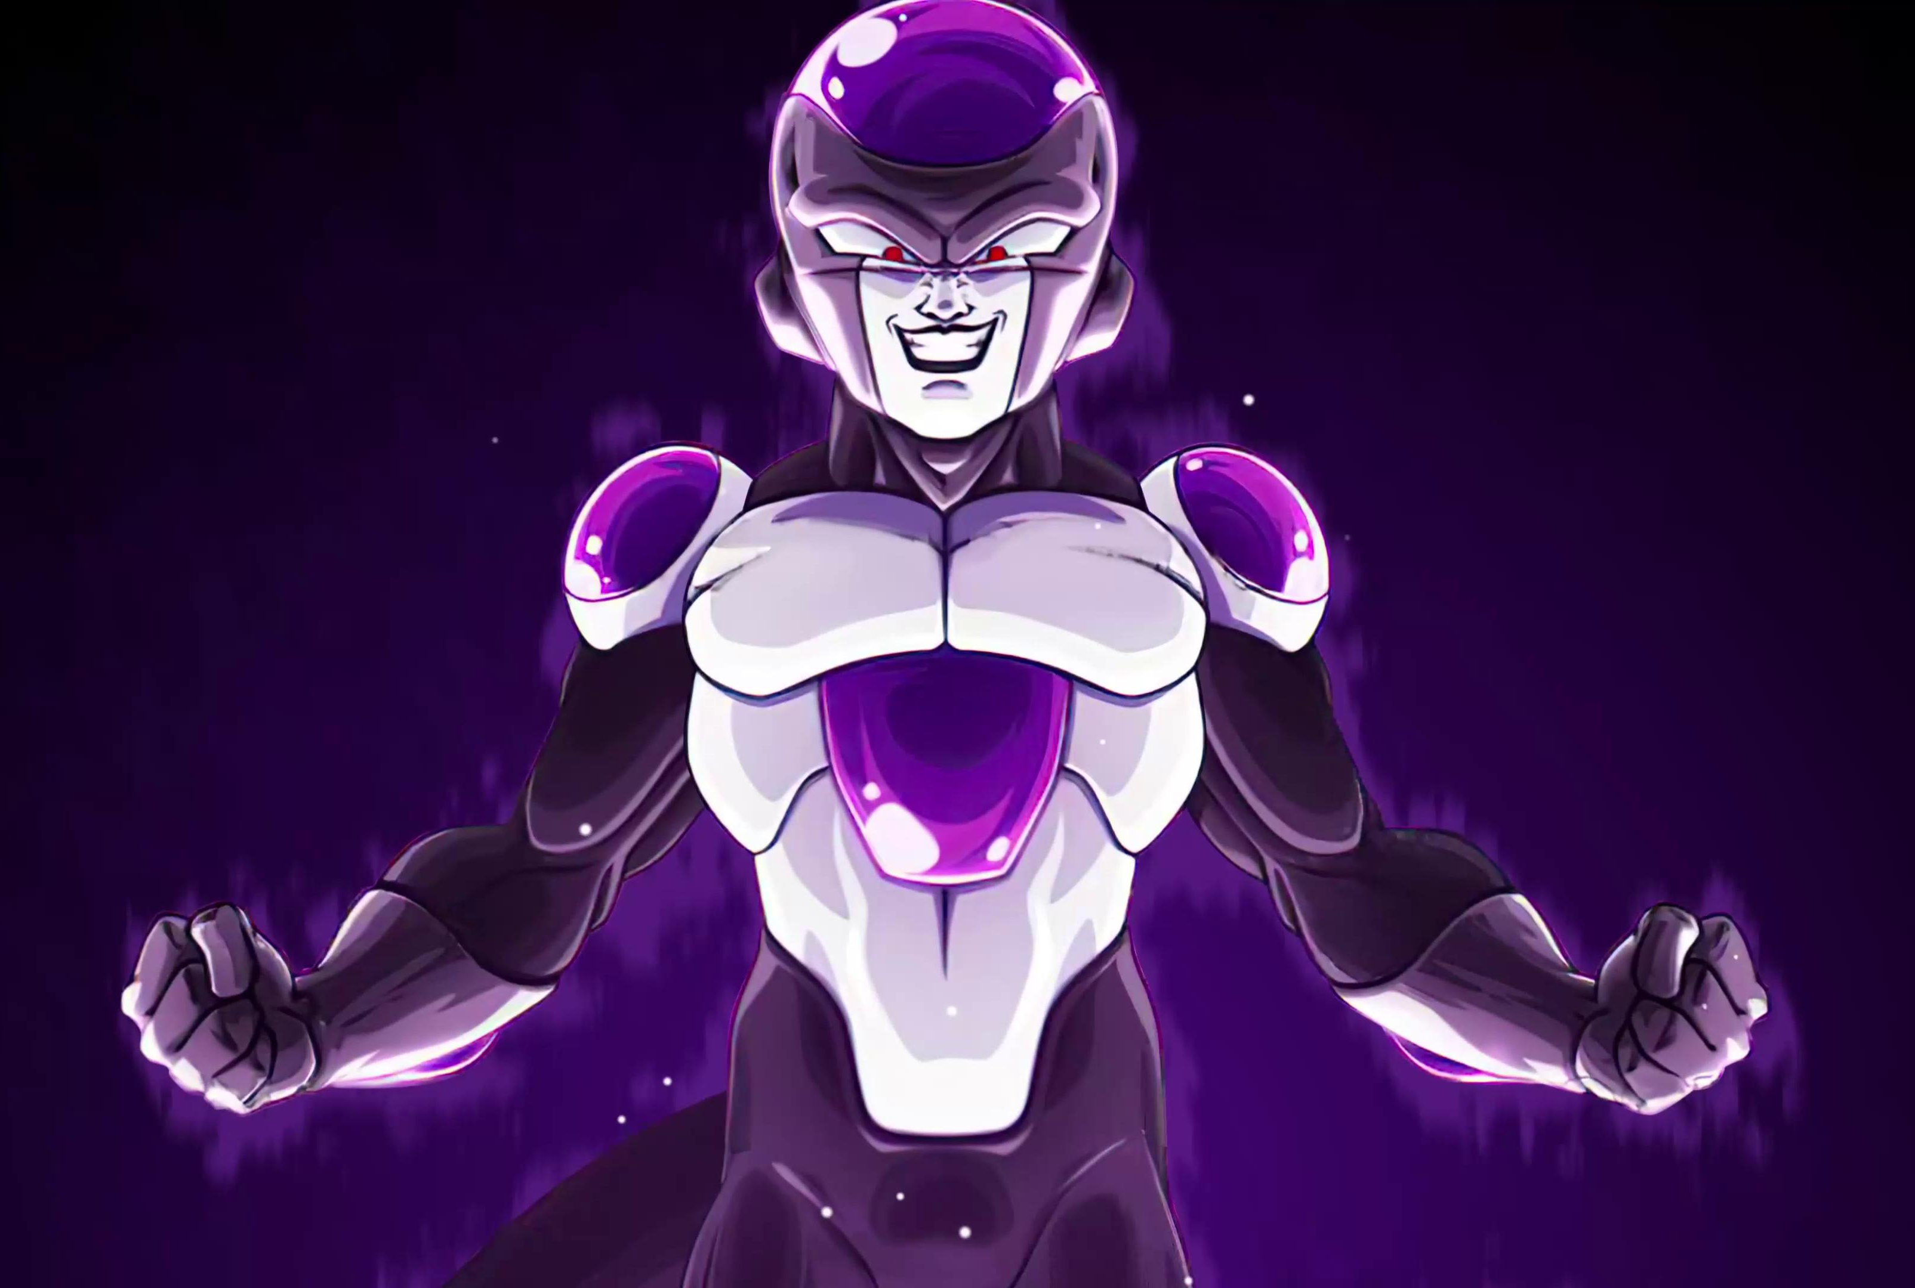
Key Arcs
Saiyan Saga – Arrival of Raditz, Vegeta, and Nappa.
Frieza Saga – Epic battle on Namek.
Cell Saga – Androids and the Cell Games.
Buu Saga – Majin Buu's many forms.
Tournament of Power – Multiversal showdown in Super

Slide 7
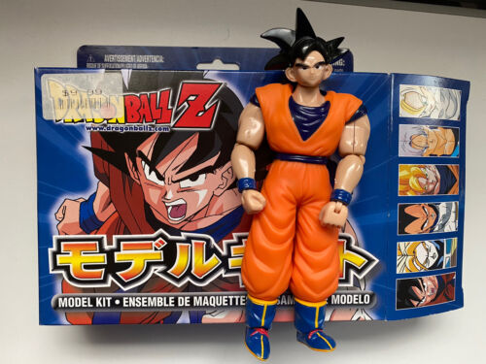
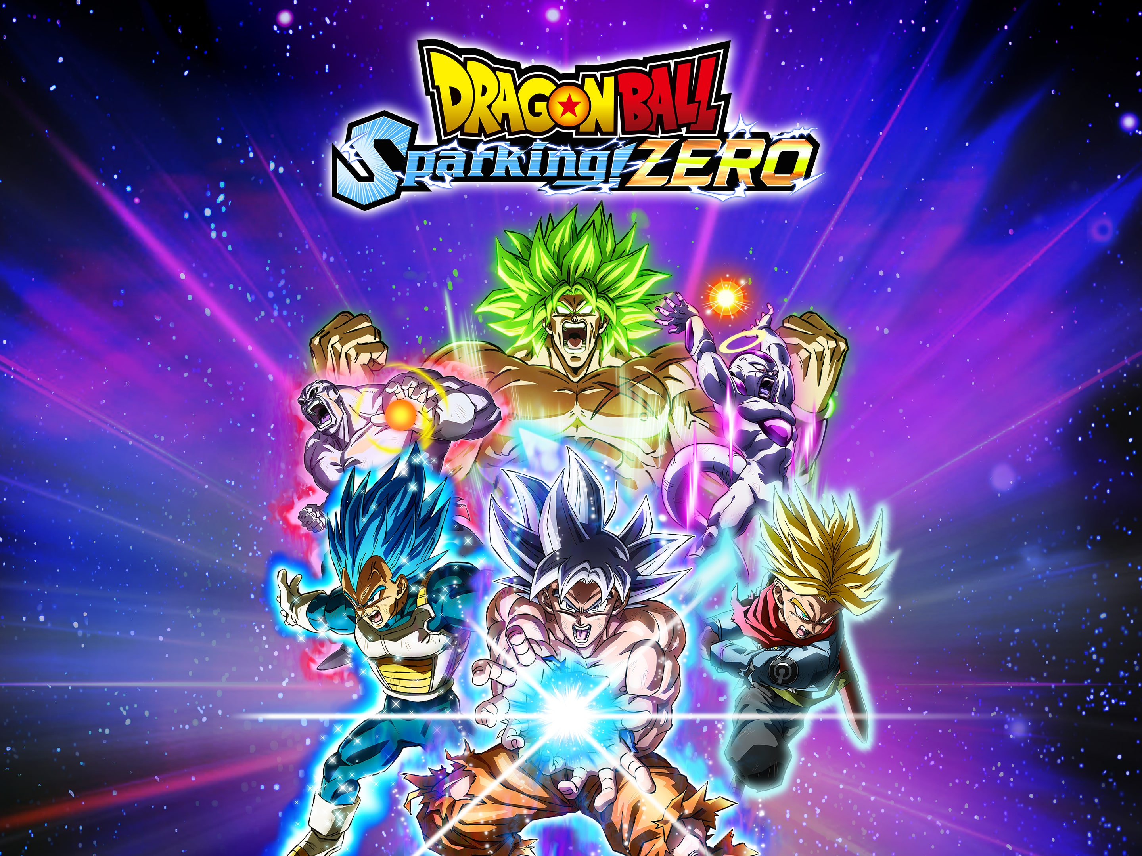
Cultural Impact
Worldwide popularity and fanbase.
Influence on other anime and media.
Merchandise, games, movies, and memes

Slide 8
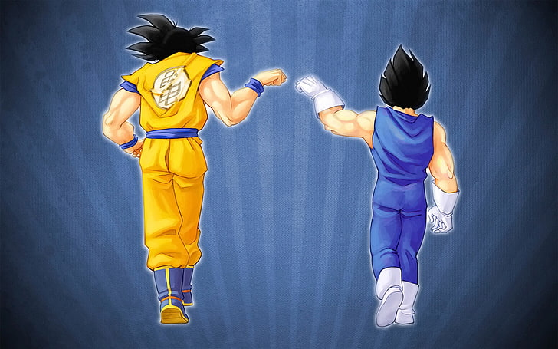
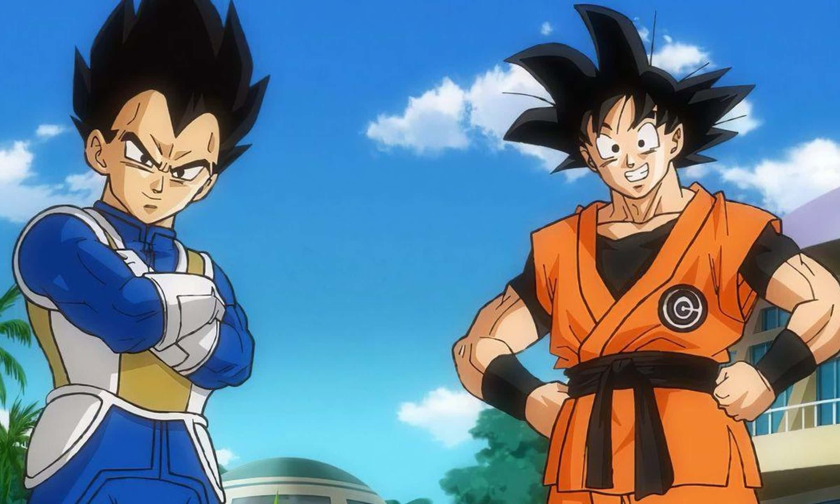
Legacy
Dragon Ball’s influence over the last 40+ years.
Continued relevance with new content and fan engagement

Slide 9
Fun Facts
Goku's original inspiration was the Monkey King from Journey to the West.
“Over 9000!” became a viral meme.
Vegeta’s character development is one of the most praised

Slide 10
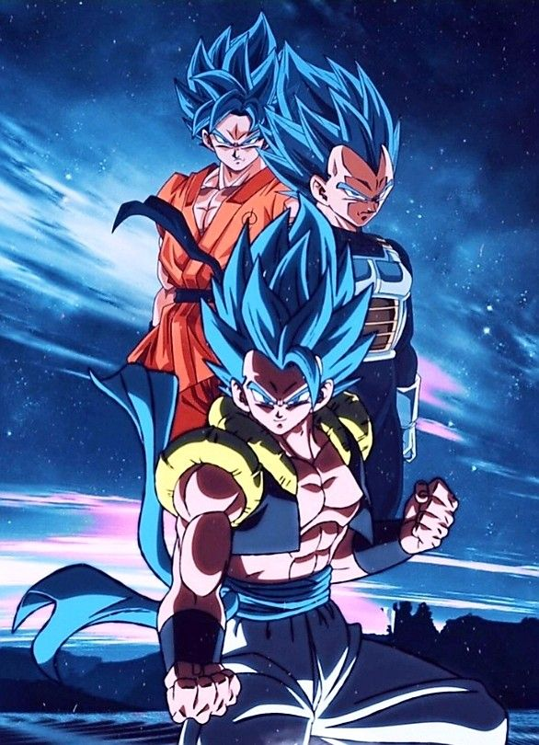
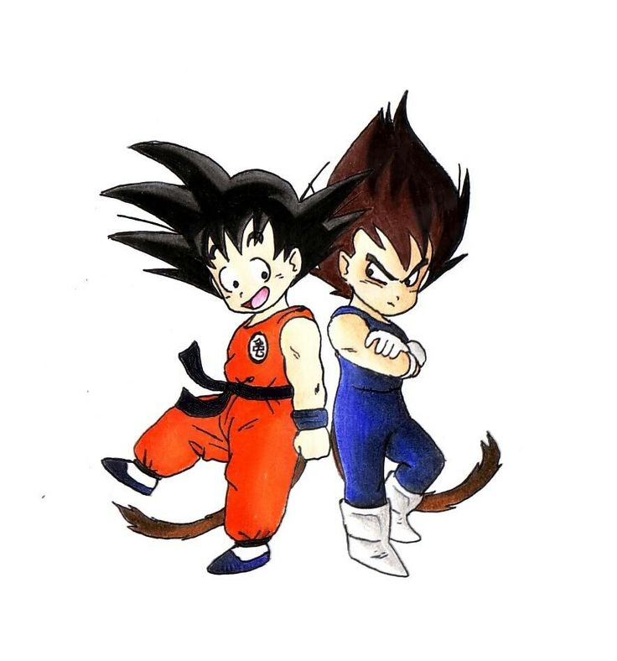
Conclusion
Dragon Ball is more than an anime – it’s a cultural phenomenon.
Themes of perseverance, growth, and friendship continue to resonate.

